Slide 1
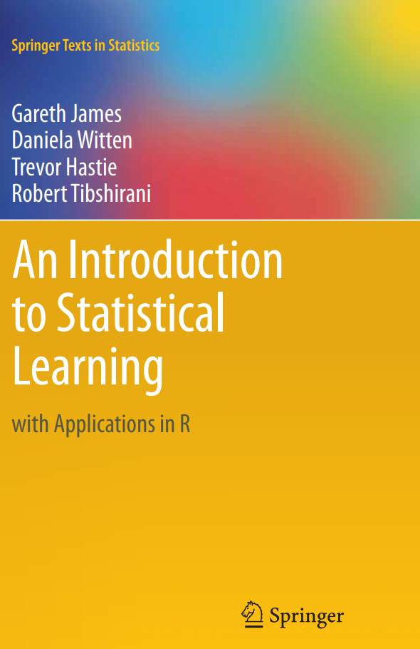
ISE-529 Predictive Analytics
Module 2: Modeling Introduction
Primary text: ISLR, Chapters 1,2

Slide 2
Overview
Data Preparation for Analytics
Analytics data structures
Python data wrangling
Introduction to Statistical Learning/Modeling
Introduction to Assessing Model Accuracy

Slide 3
Data Preparation for Analytics

Slide 4
Data Structures for Analytics
Introduction
There is generally a need to convert standard data structures from data sources into structures suitable for analytics
This is a primary topic of DSCI/ISE-559
Most standard analytics packages (including Python/Pandas) operate primarily on “rectangular data” (rows and columns)

Slide 5
Data Structures for Analytics
Rectangular Structured Data
From the perspective of a data scientist, at the most basic level we deal with data in a row/column data structure consisting of entities and their attributes.
Entities are “things” and are in the rows of our analytical base table.
Customers, orders, cars, people, etc …
Also referred to as objects, records, cases, samples, instances, points …
Attributes are properties or characteristics of the object
Eye color, temperature, price, etc …
Also referred to as measures, measures, dimensions, variables, features, ...

Slide 6
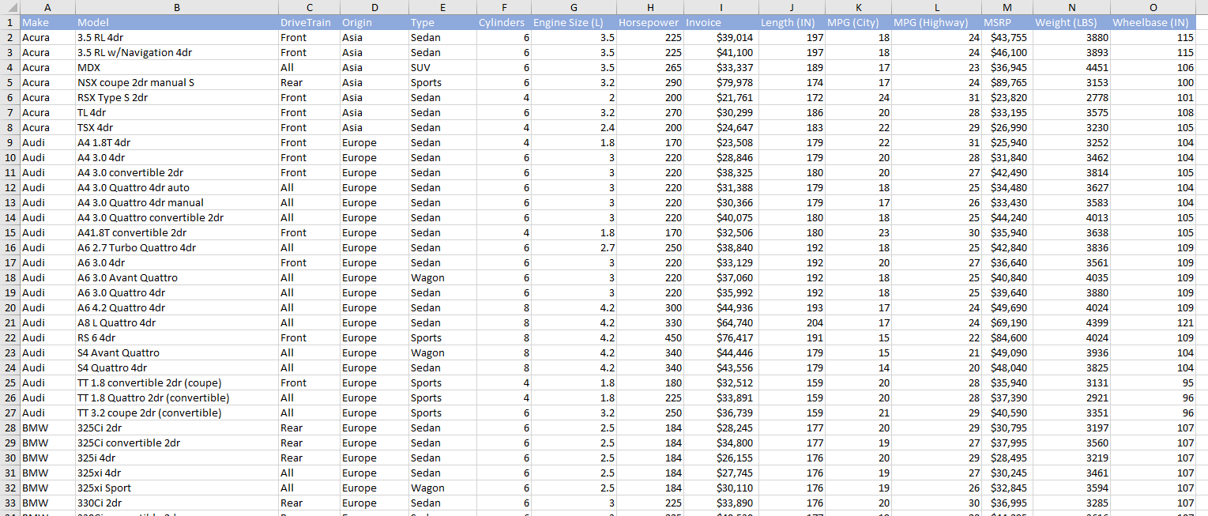
Attributes/Measures
Entities/Objects

Slide 7
Attributes
Attributes contain one of two types of information about observations:
Quantitative (numeric) data
“Measures” that are used to perform a variety of arithmetic operations
Qualitative data
“Categories” that are used to group and sub-total the observations

Slide 8
Four Basic Attribute Types
Attribute | Description | Examples | Operations
Nominal | “Name” or identifier. Represents some category or state (also referred as categorical attributes) There is no order (rank, position) among values of nominal attribute | Gender, marital status, occupation, ID numbers, zip codes | =, <>
Ordinal | Similar to nominal except the values have a meaningful order | Street number, grades, ranks, | =, <> <, >
Interval | Differences between values is meaningful | Dates, temperature in C or F | =, <>, <, > +/-
Ratio | Similar to nominal except there is a “true zero” so it is meaningful to talk about ratios between values | Dates in K, age, monetary value, mass, length | =, <>, <, > +/- * /
Qualitative (Categories)
Quantitative Measures
* Quantitative attributes can be further sub-divided into discrete and continuous

Slide 9
Attribute Types - Examples
The attributes below are contained in a database of books published in the last 25 years. For each attribute, identify whether it is a measure or a category and then for the measures whether it is of type interval or ratio and for the categories whether it is of type ordinal or nominal:
Attribute | Category/Measure | Interval/Ratio Nominal/Ordinal
Title
Author
ISBN Number (unique alphanumeric identifier)
Year of Publication
Number Sold
Genre (fiction, science, history, etc.)
Number of pages
Average user review (Excellent, Good, Fair, Poor)
Average academic review (scale of 300-700)

Slide 10
Attribute Types - Examples
The attributes below are contained in a database of books published in the last 25 years. For each attribute, identify whether it is a measure or a category and then for the measures whether it is of type interval or ratio and for the categories whether it is of type ordinal or nominal:
Attribute | Category/Measure | Interval/Ratio Nominal/Ordinal
Title | Category | Nominal
Author | Category | Nominal
ISBN Number (unique alphanumeric identifier) | Category | Nominal
Year of Publication | Category or Measure | Nominal or Interval
Number Sold | Measure | Ratio
Genre (fiction, science, history, etc.) | Category | Nominal
Number of pages | Measure | Ratio
Average user review (Excellent, Good, Fair, Poor) | Category | Ordinal
Average academic review (scale of 300-700) | Measure | Interval

Slide 11
Attribute Types – Difficult Cases
In some cases (as with year of publication), it is difficult to decide if an attribute should be treated as a measure or a category, particularly in the case of integer attributes with a finite number of possible values.
A good rule of thumb is to ask if it makes sense to think about the “average” or “total” of that attribute across some number of entities (in which case its probably a measure) or if it makes more sense to think about the number of observations that have that category value (in which case its probably a category)
Should cylinders be treated as a category or a measure?

Slide 12
Analytic-Ready Data
Data models that are optimized for operational and transactional systems are NOT suitable for analytics and reporting purposes.
Optimized for easy retrieval and update of records having certain critical identifiers
Optimized to remove redundant data (normalization)
In early days of BI, Kimball defined the “dimensional data model” for use in data warehouses
Facilitates data retrieval/analysis
Easily understood by business analysts

Slide 13
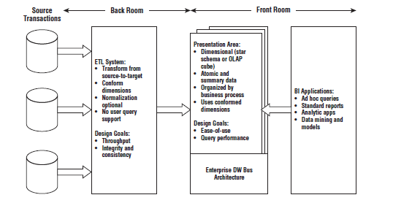
Kimball DW/BI Architecture

Slide 14
Relational vs Dimensional Data Structures
Relational Model
Designed for optimized read/update/delete processing of individual transactions
“Normalized” data model eliminates redundant data
Because there is no redundant data, there is no possibility of inconsistencies
Dimensional Model
Designed for optimized summarization and filtering of large numbers of transactions
“Denormalized” data model allows significant redundancy as a tradeoff for analytics and reporting efficiency
Easier for analyst to understand

Slide 15
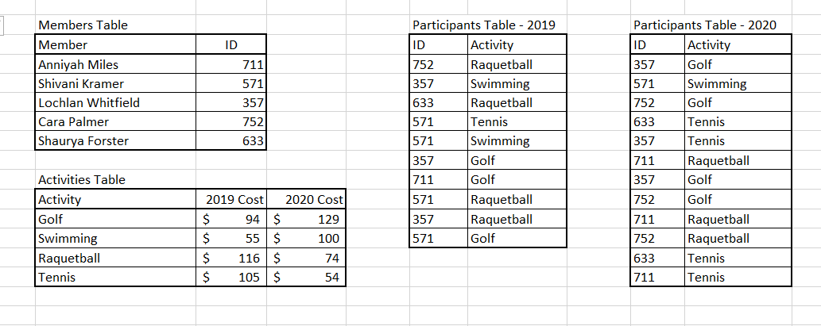
Example – Activity Signup
Relational Model
Suppose you want to write a report summarizing the total fees per member?

Slide 16
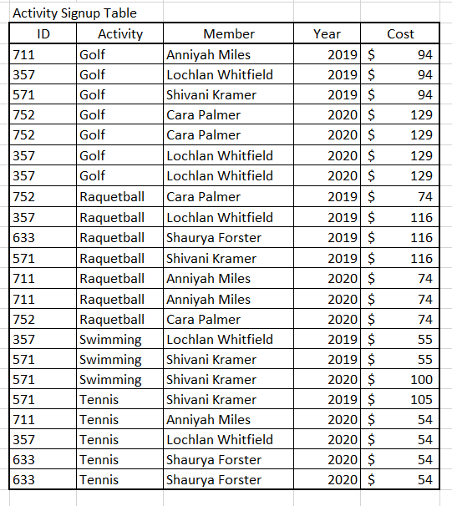
Example – Activity Signup
Relational Model vs Dimensional Model
Relational Model
Dimensional Model
Same data appears multiple times, using excess space and, more importantly, raising the possibility of inconsistent entries

Slide 17
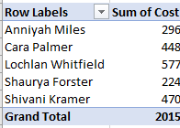
Example – Activity Signup
Dimensional Model
Now, to write a report summarizing total cost per member is a simple matter of applying filters, for example, with an Excel pivot table:

Slide 18
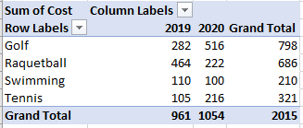
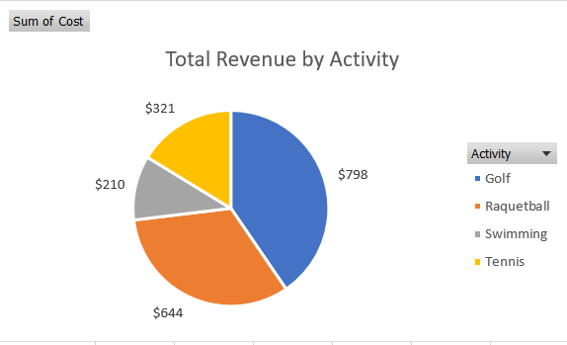
Example – Activity Signup
Dimensional Model
Or many other types of reports and analyses:

Slide 19
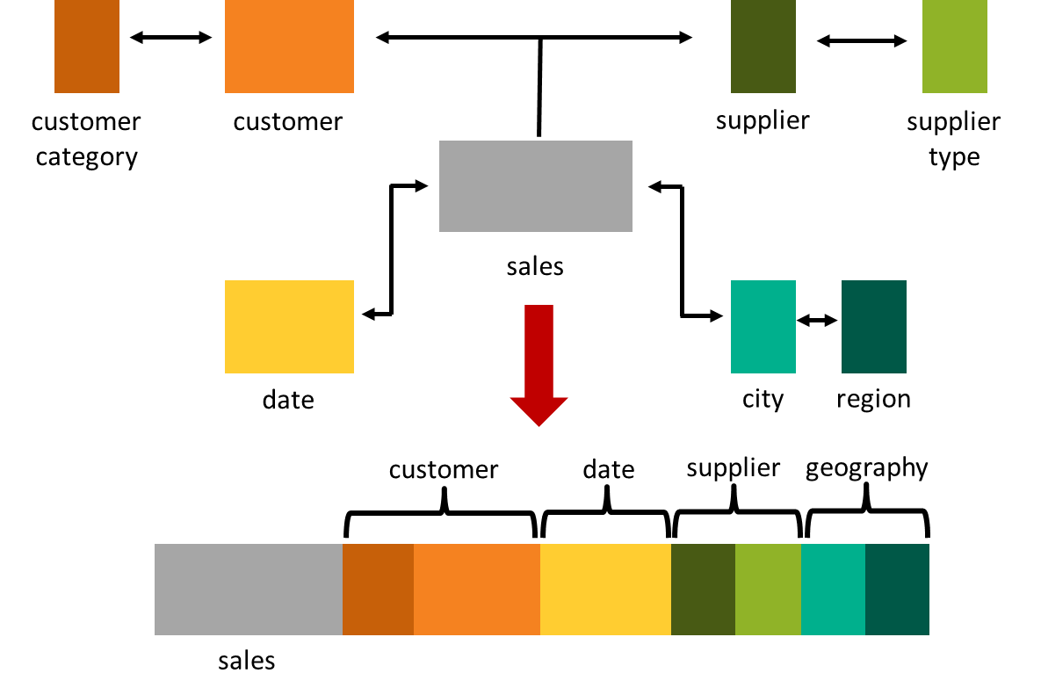
Data De-Normalization Overview

Slide 20
Data Wrangling
Join, Combine, and Reshape

Slide 21
Data Wrangling
Outline
Combining and merging datasets
Reshaping and pivoting
Data aggregation and group operations
Noisy/missing value treatment
Format standardization
Hierarchical indexing (provided for reference)

Slide 22
Combining and Merging Datasets
Overview
Data in Pandas objects can be combined in three basic ways:
pandas.merge – connects rows based on one or more keys (equivalent to SQL join operations)
pandas.concat – concatenates or “stacks” objects along an axis
combine_first – splices together overlapping data to fill in missing values in one object with values from another

Slide 23
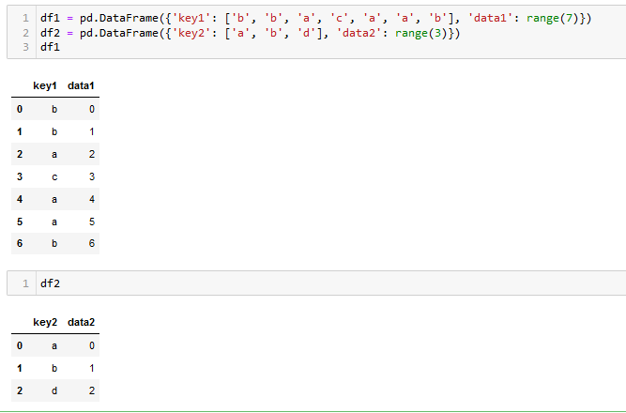
Merging Datasets
Database-Style DataFrame Joins

Slide 24
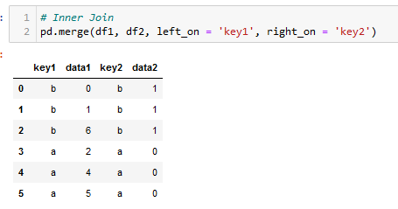
Merging Datasets
Database-Style DataFrame Joins

Slide 25
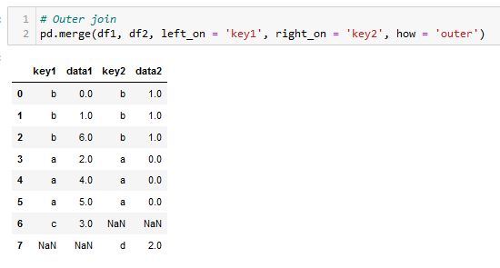
Merging Datasets
Database-Style DataFrame Joins

Slide 26
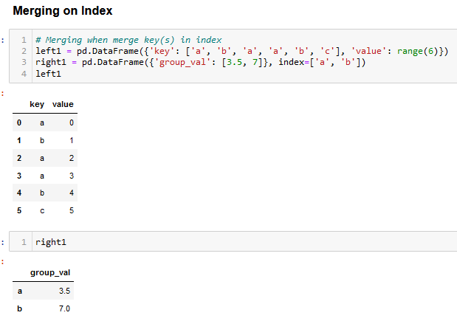
Merging Datasets
Database-Style DataFrame Joins

Slide 27
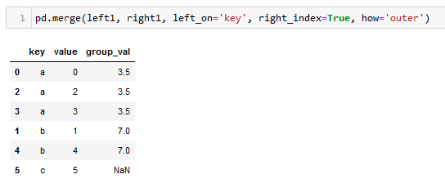
Merging Datasets
Database-Style DataFrame Joins

Slide 28
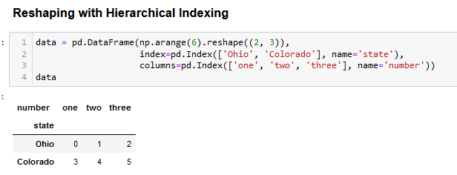
Reshaping and Pivoting
Reshaping with Hierarchical Indexing

Slide 29
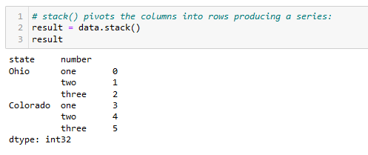
Reshaping and Pivoting
Reshaping with Hierarchical Indexing

Slide 30
Pandas DataFrame Manipulation Functions
Pandas provides a number of functions to manipulate dataframes to enable you to get them into an appropriate format. Key functions include:
“Melt”: combine multiple columns into a single column with a key-value pair format (“Pivot Longer”)
“Pivot”: divide key-value rows into columns (“Pivot Wider”)
“Split”: split a single variable into multiple variables. Useful when values represent many attributes (e.g., sex and age).
“Combine”: merge two columns (variables) into one (pasting together)

Slide 31
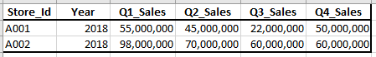
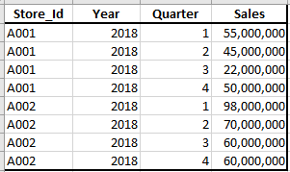
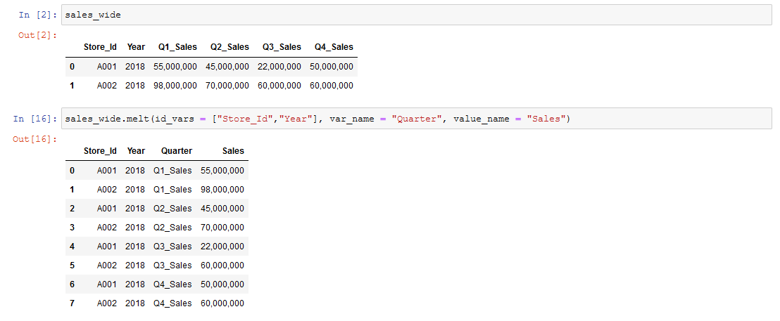
DataFrame Manipulation Functions
Melt() Method
Syntax
df.melt(
id_vars=None, # ID Columns (not to be modified)
value_vars=None, # Columns to “unpivot” (if not specified, then all columns except ID Columns will be used
var_name=None, # Name for new variable column
value_name='value’, # Name for new value column
col_level=None, # Used for MultiIndex columns
ignore_index=True) # Used to retain original index

Slide 32
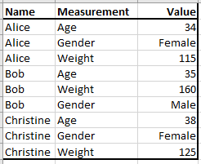
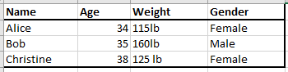
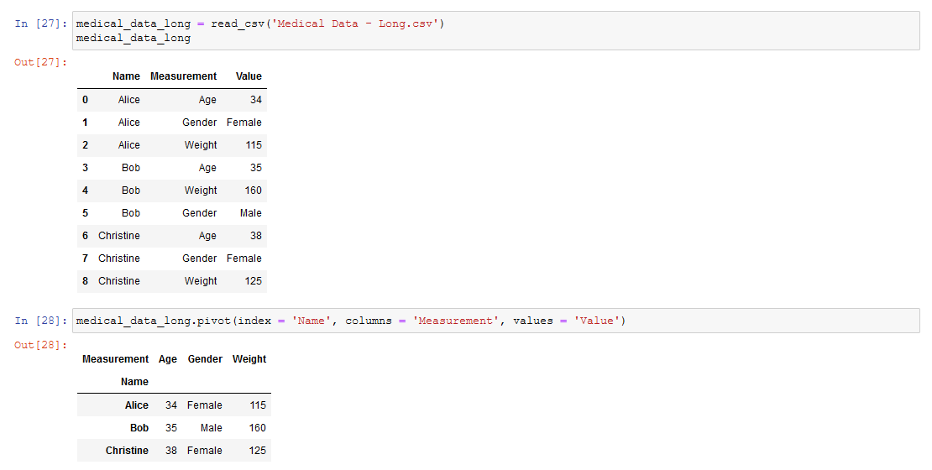
Pandas DataFrame Manipulation Functions
Pivot() Method
Syntax
df.pivot( # “long” DataFrame
index = # column to use for new df index
columns = # column(s) to use to get new column names
Values = # column(s) to use to get new values

Slide 33
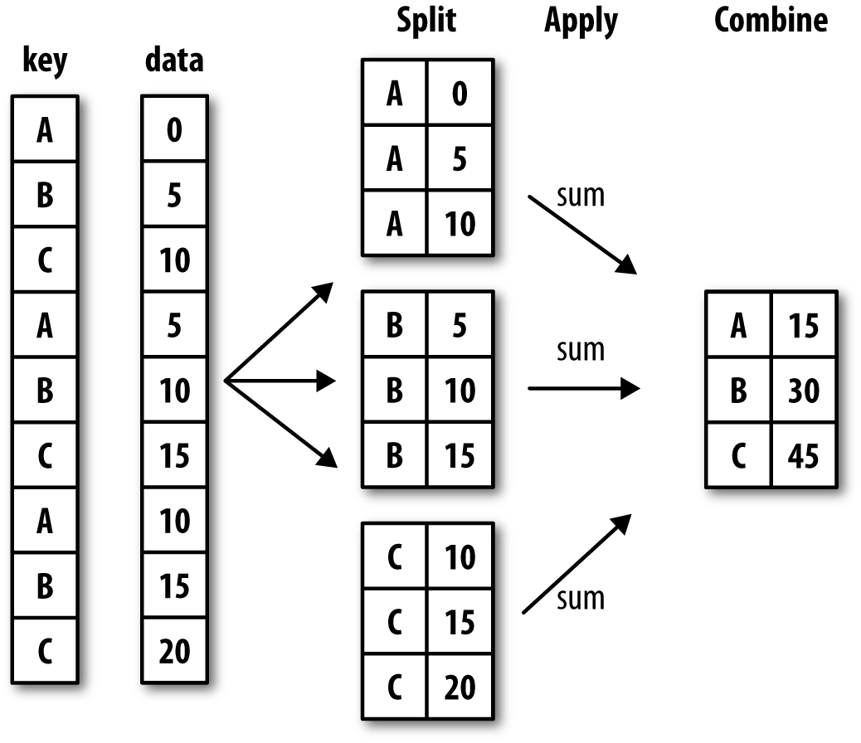
Data Aggregation and Group Operations
Split-Apply-Combine

Slide 34
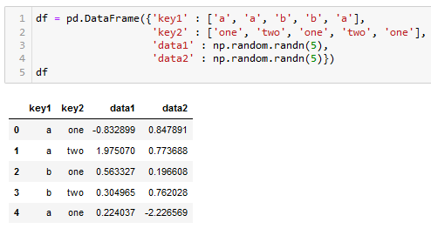
Data Aggregation and Group Operations

Slide 35
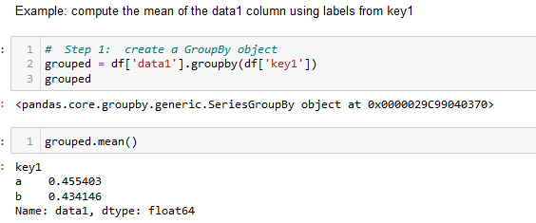
Data Aggregation and Group Operations

Slide 36
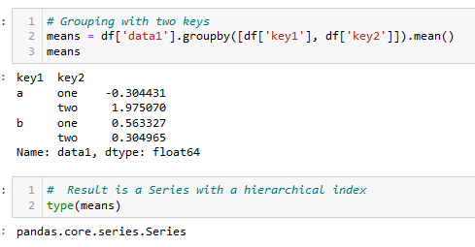
Data Aggregation and Group Operations

Slide 37
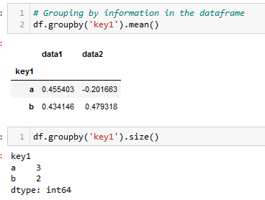
Data Aggregation and Group Operations

Slide 38
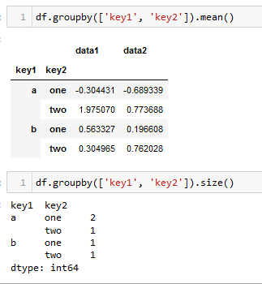
Data Aggregation and Group Operations

Slide 39
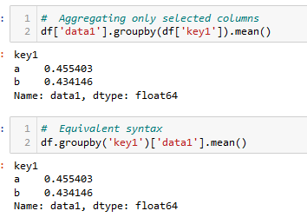
Data Aggregation and Group Operations

Slide 40
Noisy/Missing Value Treatment
Primary Data Quality Issues
Data cleaning generally involves detecting and addressing the following primary data quality issues:
Incomplete data (variables with missing values)
Extreme outliers (values that are incorrect with high probability)
Unreasonably high or low
Negative values for variables that should be non-negative
Inconsistent data
For example, birthdate and age consistent
Intentionally disguised data
For example, everyone’s birthday is January 1

Slide 41
Noisy/Missing Value Treatment
Options for Handling Incomplete/Missing Data
Ignore the observation—not effective when the % of missing values per attribute varies considerably
Fill in it automatically (imputation) with
A global constant : e.g., “unknown”, a new class?
The attribute mean
The attribute mean for all samples belonging to the same class
The most probable value: inference-based such as Bayesian formula or decision tree
The best process for handling missing, noisy, and outlier data is dependent on your intended subsequent use of the Analytics Data Mart

Slide 42
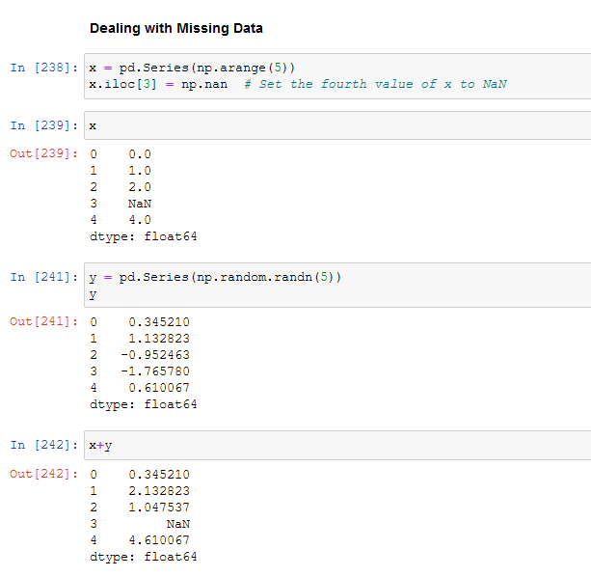
Noisy/Missing Value Treatment
Pandas Functions for Handling Missing Data

Slide 43
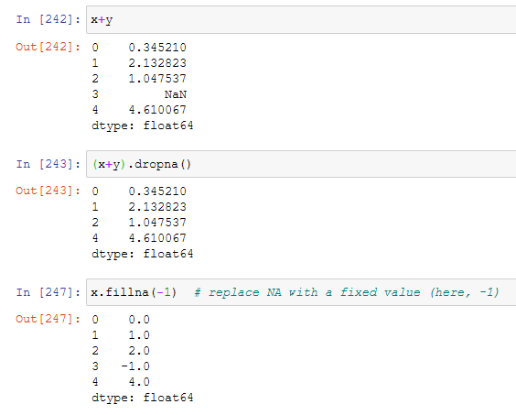
Noisy/Missing Value Treatment
Pandas Functions for Handling Missing Data
Key Pandas functions for handling missing data are dropna() and fillna()

Slide 44
Noisy/Missing Value Treatment
General Pandas Procedures
When summing the data, missing values will be treated as zero
If all values are missing, the sum will be equal to NaN
cumsum() and cumprod() methods ignore missing values but preserve them in the resulting arrays
Missing values in GroupBy method are excluded (just like in R)
Many descriptive statistics methods have skipna option to control if missing data should be excluded . This value is set to True by default (unlike R)

Slide 45
Noisy/Missing Value Treatment
Methods for Handling Missing Values
df.method() | description
dropna() | Drop missing observations
dropna(how='all') | Drop observations where all cells is NA
dropna(axis=1, how='all') | Drop column if all the values are missing
dropna(thresh = 5) | Drop rows that contain less than 5 non-missing values
fillna(0) | Replace missing values with zeros
isnull() | Returns True if the value is missing
notnull() | Returns True for non-missing values

Slide 46
Format Standardization
In general, format standardization is an issue in two areas:
Categories
Often represented by text strings but sometimes by numbers (usually integers)
Inconsistent representation of category values
Dates
Inconsistent data formats used from multiple data sources

Slide 47
Format Standardization - Categories
Pandas contains a “categorical” datatype
May or may not have an “order”
All values of categorical data are either in the defined list of values or are np.nan
Numerical operations not possible

Slide 48
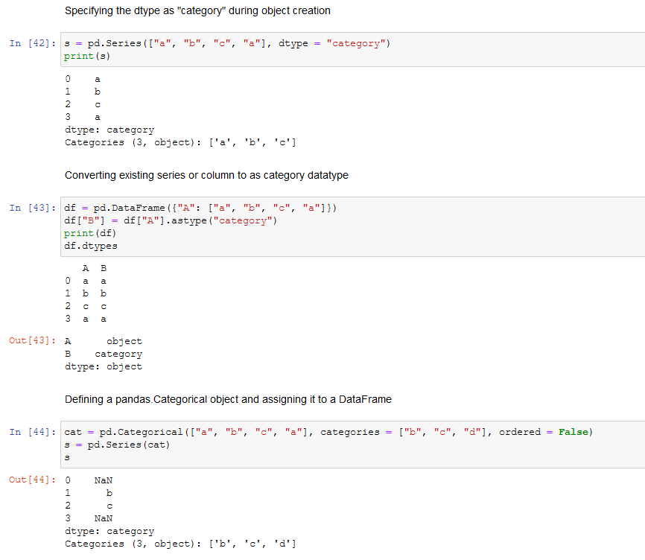
Format Standardization - Categories
Series Creation
Why are these NaN?

Slide 49
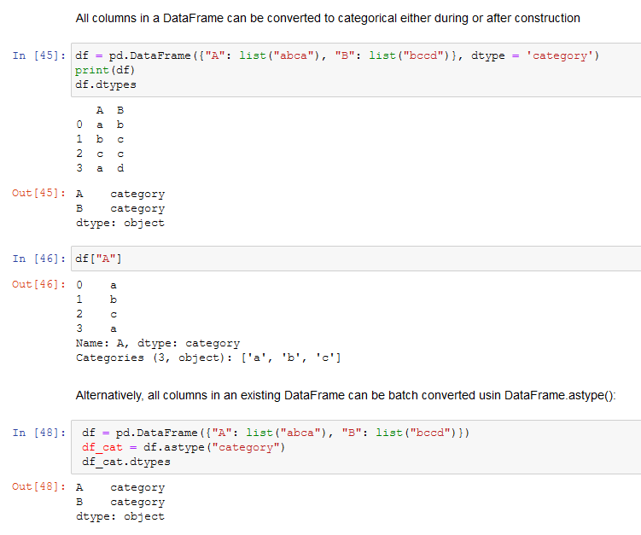
Format Standardization - Categories
DataFrame Creation

Slide 50
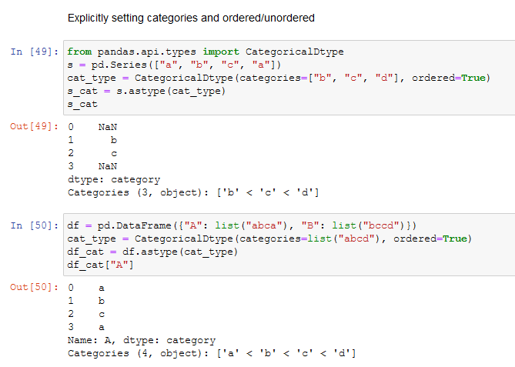
Format Standardization - Categories
Controlling Behavior

Slide 51
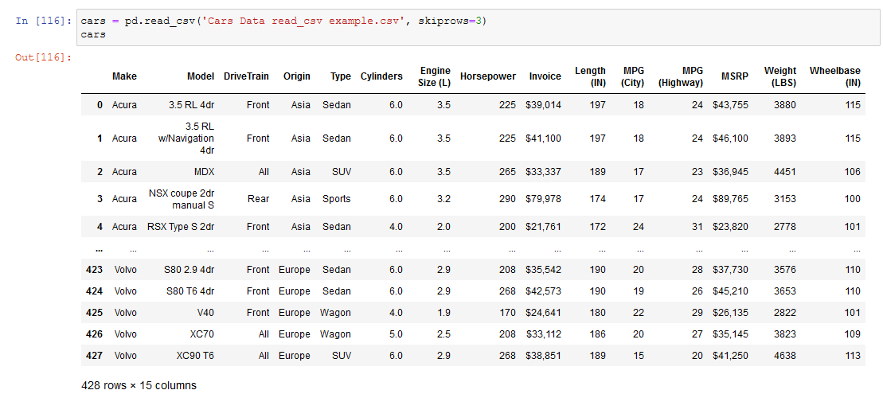
Format Standardization - Categories
Cars Example

Slide 52
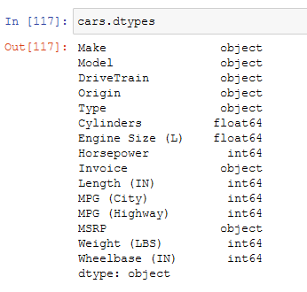
Format Standardization - Categories
Cars Example
Which dtypes do we want to make categories?
Which dtypes do we want to make integers (that aren’t already)?

Slide 53
Format Standardization - Categories
Cars Example
We want these to be categories
We want these to be integers

Slide 54
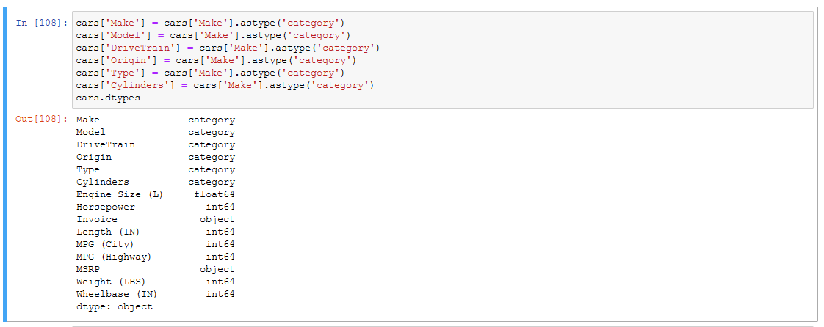
Format Standardization - Categories
Cars Example

Slide 55
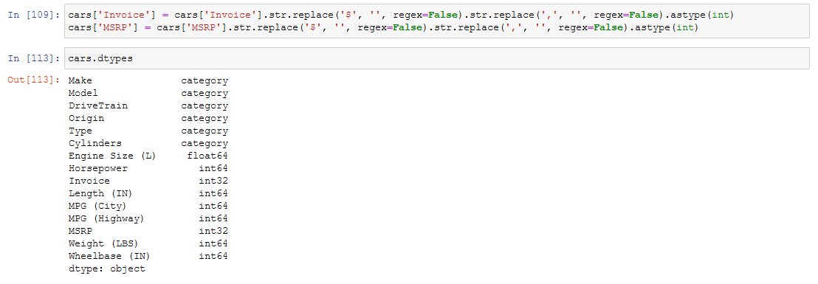
Format Standardization - Categories
Cars Example

Slide 56
Format Standardization
Working With Dates and Times
Depending on the type of analysis you are doing, date and time variables often require special handling due to the characteristics of our date/time systems related to physical phenomena (rotation of earth and its orbit around the sun) and geopolitical phenomena (time zones, daylight savings time, etc.) For example:
Does every year have 365 days?
Does every day have 24 hours?
Does every minute have 60 seconds?

Slide 57
Format Standardization
Working With Dates and Times
Pandas has extensive capabilities for working with date
We won't generally be working with complicated time systems in this class, but further documentation can be found here:
https://pandas.pydata.org/pandas-docs/stable/user_guide/timeseries.html

Slide 58
Hierarchical Indexing

Slide 59
Hierarchical Indexing
Overview
Pandas feature that enables multiple index levels on the same axis
Provides a way to work with higher dimensional data in a lower dimensional form

Slide 60
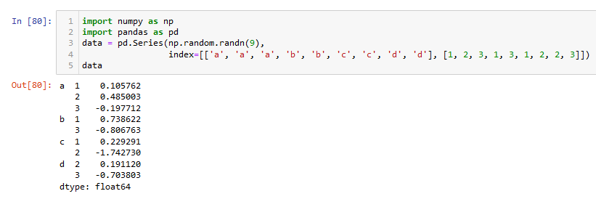
Hierarchical Indexing
Series Example

Slide 61
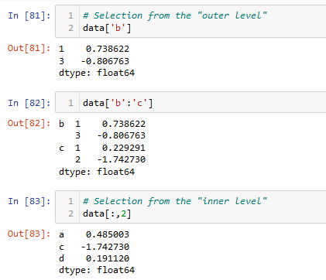
Hierarchical Indexing
Series Example

Slide 62
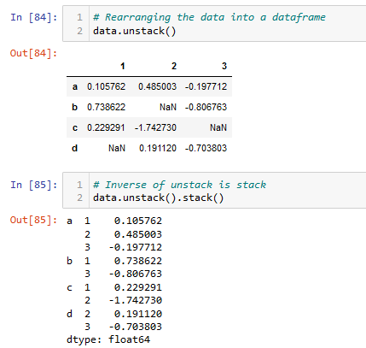
Hierarchical Indexing
Series Example

Slide 63
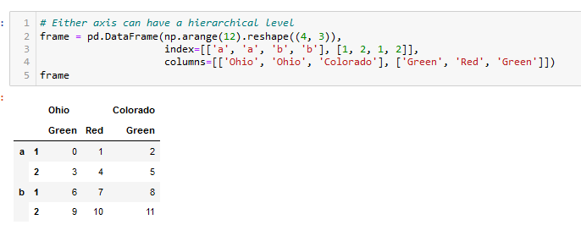
Hierarchical Indexing
Dataframe Examples

Slide 64
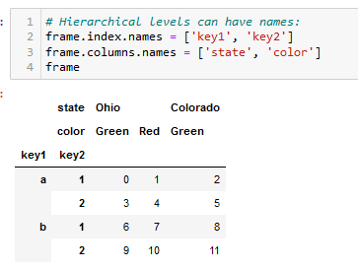
Hierarchical Indexing
Dataframe Examples

Slide 65
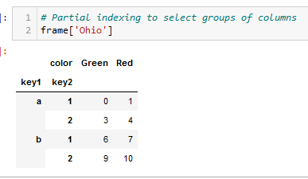
Hierarchical Indexing
Dataframe Examples

Slide 66
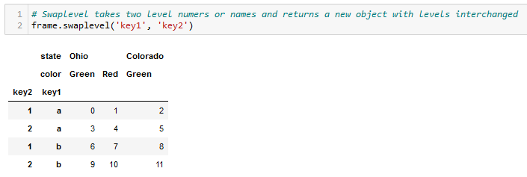
Hierarchical Indexing
Reordering and Sorting Levels

Slide 67
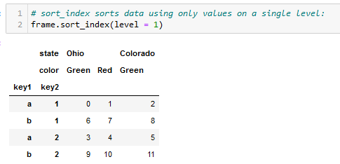
Hierarchical Indexing
Reordering and Sorting Levels

Slide 68
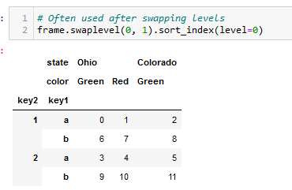
Hierarchical Indexing
Reordering and Sorting Levels

Slide 69
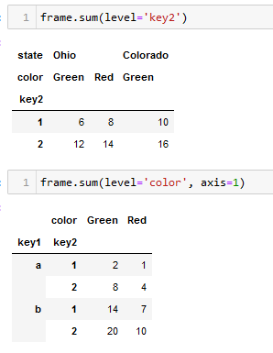
Hierarchical Indexing
Summary Statistics by Level

Slide 70
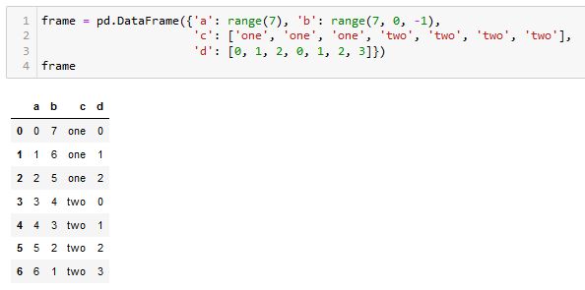
Hierarchical Indexing
Indexing with a DataFrame’s Columns

Slide 71
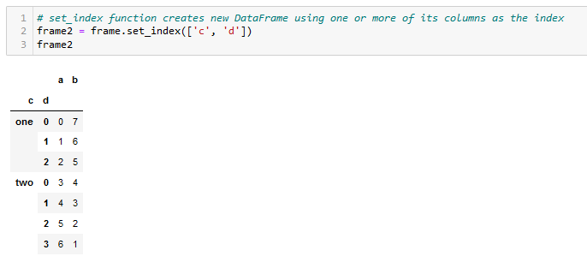
Hierarchical Indexing
Indexing with a DataFrame’s Columns

Slide 72

Hierarchical Indexing
Indexing with a DataFrame’s Columns

Slide 73
Introduction to Statistical Learning/Modeling

Slide 74
Modeling Types
First major distinction is between supervised and unsupervised learning
Unsupervised learning does not have a response variable in the data
Clustering is a primary technique
Unsupervised learning is the focus of ISE-535 (Data Mining)
Second major distinction in supervised learning is based on the type of the response variable
Continuous – "Regression"
Categorical – "Classification"

Slide 75
Brief History of Statistical Learning
Early 1800s: Least Squares method developed by Legendre (1805) building on the work of Gauss (1795)
Direct predecessor of Linear Regression
Used for predicting quantitative values
1936: Linear Discriminant Analysis method developed by Fisher for predicting qualitative values (categories)
1940s: Multiple authors proposed an alternate approach called Logistic Regression

Slide 76
Brief History of Statistical Learning
1970s: Generalized Linear Model (GLM) developed to describe an entire class of statistical learning methods
Linear and Logistic Regression models are special cases of the GLM
Until 1980s, statistical learning techniques were almost exclusively linear models because fitting non-linear models was beyond the computational capacity of that time.

Slide 77
Brief History of Statistical Learning
Starting in the 1980s, computational power enabled the development of new classes of flexible techniques not based on linear models:
1980s: Classification and Regression Trees
1980s: Neural Networks
1990s: Support Vector Machines

Slide 78
Statistical Learning vs Machine Learning
Machine Learning arose as a subfield of Artificial Intelligence
Statistical Learning arose as a subfield of Statistics
There is now significant overlap in the terms
Machine learning emphasizes large scale applications and prediction accuracy
Statistical learning emphasizes models, their interpretability, precision, and uncertainty

Slide 79
Modeling Goals
“To Explain or to Predict?”
Models are developed for two reasons
To better understand the underlying dynamics and behaviors of a “system” (“modeling for inference”)
To enable the development of algorithmic models that can predict a response variable or variables for previously unseen data (“modeling for prediction”)

Slide 80


"Analytical Models"

Slide 81


Supplemental (Optional) Materials

Slide 82
Notation Introduction
ISLR, Chapter 1

Slide 83

Initial Example
Predicting Income
Predictors
Response Variable

Slide 84

Notation
Wage Dataset Example
Standard notation:
$n$: number of distinct data points, or observations
$p$: number of variables available for use in making predictions
Wage dataset contains 11 variable for 3,000 people
$n=3,000$
$p=11$

Slide 85


Standard Notation
$x_{ij}$ represents the value of the $j^{th}$ variable of the $i^{th}$ observation where $i=1,2,…,n$ and $j=1,2,…,p$
Thus, the predictor matrix $X$ is represented as an $n×p$ matrix:
$$X= \left[\begin{matrix}x_{11} & x_{12} & ⋯ & x_{1p} \\ x_{21} & x_{22} & ⋯ & x_{2p} \\ ⋮ & ⋮ & ⋱ & ⋮ \\ x_{n1} & x_{n2} & ⋯ & x_{np}\end{matrix}\right]$$

Slide 86


Standard Notation
Referencing rows of $X$:
$$x_{1}, x_{2},…,x_{n}$$
where $x_{i}= \left[\begin{matrix}x_{i1} \\ x_{i2} \\ ⋮ \\ x_{in}\end{matrix}\right]$
Vector of length $p$ containing the variable measurements for the $i^{th}$ observation (vectors are by default represented as columns)
Referencing columns of $X$:
$$x_{1}, x_{2},…,x_{p}$$
where $x_{j}= \left[\begin{matrix}x_{1j} \\ x_{2j} \\ ⋮ \\ x_{nj}\end{matrix}\right]$

Slide 87


Standard Notation
Using this notation, the matrix $X$ can be written based on the columns of $X:$
$$X=(x_{1} x_{2} …x_{p})$$
or based on the rows of $X:$
$$X=\left[\begin{matrix}{x_{1}}^{T} \\ {x_{2}}^{T} \\ ⋮ \\ {x_{2}}^{T}\end{matrix}\right]$$
Transpose of vector:
$${x_{1}}^{T}=(x_{11} x_{21}…x_{n1}))$$

Slide 88

Standard Notation
$y_{i}$ is used to denote the $i^{th}$ observation of the variable we wish to predict, often referred to as the response variable:
$$y= \left[\begin{matrix}y_{1} \\ y_{2} \\ ⋮ \\ y_{n}\end{matrix}\right]$$
Thus, our full observed data consists of $\{\left(x_{1},y_{1}\right), \left(x_{2},y_{2}\right),…,\left(x_{i},y_{n}\right)$ where each $x_{i}$ is a vector of length $p$.

Slide 89

Standard Notation
A vector of length $n$ will always be denoted in lower case bold:
$$a= \left[\begin{matrix}a_{1} \\ a_{2} \\ ⋮ \\ a_{n}\end{matrix}\right]$$

Slide 90
Modeling Framework
Data modeling techniques can be thought of in the following manner:
Data = Model + Error
How well the selected model mirrors the true functional relationship between the predictors and response
The amount by which the model fails to represent the data accuracy

Slide 91

Initial Example
Predicting Income From Education
What would a line through this data that could be used to make predictions look like?

Slide 92

Initial Example
Predicting Income From Education
How do we find this line??

Slide 93

Initial Example
Predicting Income from Education and Seniority
How do we find this two-dimensional plane?

Slide 94
Predictive Modeling Objective
A set of approaches for estimating that line, plane, or hyperplane (plane in more than two dimensions)

Slide 95


Initial Example
$$p=2$$
Dataset metrics:
n: number of observations used to define a model. Referred to as training data.
p: number of independent predictor variables in a model.
$$n=20$$

Slide 96






Initial Example
We generally refer to the response variable as $Y$ (in this case, Sales), and the inputs as an $X$ vector:
where
$$X_{i}=\left[\begin{matrix}X_{i1} \\ X_{i2} \\ ⋮ \\ X_{ip}\end{matrix}\right]$$
$$X$$
$$X_{1}$$
$$X_{2}$$
$$Y$$
$$X=[X_{1}{ X}_{2}{…X}_{p}]$$

Slide 97





Initial Example
Specific Data Elements
$x_{ij}$: value of the $i$^{th} observation of the $j$^{th} predictor where $i=1…n$ and $j=1…p$
$$x_{32}$$
$$x_{7}$$
$$y_{7}$$

Slide 98




Initial Example
$$X$$
$x_{ij}$: value of the $i$^{th} observation of the $j$^{th} predictor where $i=1…n$ and $j=1…p$
$x_{32}$ = 100.7
$$X_{1}$$
$$Y$$
$$X_{2}$$
$$x_{32}$$
$$x_{7}$$
$$x_{7}=\left(\begin{matrix}x_{71} \\ x_{72}\end{matrix}\right)=\left(\begin{matrix}19.9 \\ 150.3\end{matrix}\right)$$

Slide 99

Initial Example
We write our model as:
Random error term with mean 0
$$Y=f\left(X\right)+ ε$$
Scalar response variable
Vector of predictor variables

Slide 100

Why Are We So Interested In Finding $f\left(X\right)?$
Prediction: with a good $f,$ we can make predictions of $Y$ for newly encountered entities with $X=x$
Inference: We can sometimes understand which components of $X=(X_{1},X_{2}, …X_{p}$) are important in explaining $Y$ and the nature of their influences.
Capital-letters denote variables (in this case, a vector)
Lower case denotes specific values

Slide 101



Prediction
Since the error term $ε$ averages to zero, we can predict $Y$ using:
$$\hat{Y}=\hat{f}(X)$$
Estimate for $Y$
Estimate for $f$

Slide 102

Prediction
Accuracy of $\hat{Y}$
Accuracy of $\hat{Y}$ as an estimator for $Y$ depends on two quantities:
Reducible error: Error due to $\hat{f}$ not being a perfect estimate of $f$
Called “reducible” because of the possibility of improving $\hat{f}$
Irreducible error: Error due to $ε$ – inherent randomness in our estimator of $Y$ that would exist even if we had a “perfect” model
Due to unmeasured variables that can be useful in predicting $Y$ or unmeasurable variation

Slide 103


Prediction
Accuracy of $\hat{Y}$
Generally, we measure the quality of candidate $f\left(X\right)$ regression functions by the square of the prediction error:
$$E{(Y−\hat{Y})}^{2} = {E[f\left(X\right)+ε−\hat{f}\left(X\right)]}^{2} \\ = {[f\left(X\right)−\hat{f}\left(X\right)]}^{2}+Var(ε)$$
Reducible
Irreducible
Focus of prediction is estimating $f$ with a goal of minimize reducible error

Slide 104

Inference
Often, the goal is to understand the association between $Y$ and $X_{1}…X_{p}$
Examples of questions we may be interested in include:
Which predictors are associated with the response (and, which of them have no apparent effect on the response)?
What is the relationship between the response and each predictor?
Increase in predictor causes increase or decrease in response?
Can the relationship between the response and each predictor be adequately summarized using a linear equation or is it more complicated?

Slide 105

How Do We Estimate $f$?
Using the predictor variables ($X$), identify our training data set
May be all or a subset of the observations (rows) of $X$
Broadly speaking, there are two basic approaches to estimating $f$:
Parametric models
Non-Parametric models

Slide 106

Parametric Models
Parametric models make an assumption about the functional form, or shape, of $f$. For example, a very simple assumption is that $f$ is linear in $X$:
$f\left(X\right)=β_{0}+β_{1}X_{1}+β_{2}X_{2}+…+$ $β_{p}X_{p}$
After this model form is selected, we just need a procedure that uses the training data to fit or train the model. In the case of the linear model above, we need to estimate the parameters $β_{0},β_{1},…,β_{p}$

Slide 107

Parametric Models
Linear Model Using Income Example

Slide 108

Non-Parametric Models
Non-parametric models make no explicit assumptions about the functional form of $f$
Instead, they seek a mapping of predictors to response variable that is as close to the data as possible without being too “wiggly”

Slide 109

Non-Parametric Models
“Smooth” Thin-Plate Spline Example

Slide 110

Non-Parametric Models
“Rough” Thin-Plate Spline Example

Slide 111

Model “Flexibility”
Some models are less “flexible” (or more “restrictive”) in the sense that they can produce a relatively small range of shapes to estimate $f$
Why would we select a less flexible model?

Slide 112

Model Flexibility vs Interpretability

Slide 113
Trade-offs
Prediction accuracy versus interpretability
Linear models easy to interpret; thin-plate splines are not!
Good fit versus over-fitting/under-fitting
Parsimony versus black-box
Generally, we prefer simpler models with fewer variables

Slide 114
Second Example
Advertising Data
We wish to predict Sales from TV, Radio, and Press by finding a function:
$$Sales ≈f(TV, Radio, Press)$$

Slide 115

Initial Example
Advertising Data
We wish to predict Sales from TV, Radio, and Press by finding a function:
$$Sales ≈f(TV, Radio, Press)$$

Slide 116



Advertising Data
We wish to predict Sales from TV, Radio, and Press by finding a function:
$$Sales ≈f(TV, Radio, Press)$$

Slide 117
How Can We Model and Predict Sales From Radio Expenditure?
How would you go about predicting the Sales for a new campaign with Radio advertising expenditures of 30?

Slide 118






Notation
Reminder: we generally refer to the response variable as $Y$ (in this case, Sales), and the inputs as an $X$ vector:
where
$$x_{i}= \left(\begin{matrix}x_{i1} \\ x_{i2} \\ ⋮ \\ x_{ip}\end{matrix}\right)$$
$$X$$
$$X_{1}$$
$$X_{2}$$
$$X_{3}$$
$$Y$$
$$X= \left(\begin{matrix}x_{1}{ x}_{2}{…x}_{p}\end{matrix}\right)$$

Slide 119


Finding an ideal $f(X)$
What is a good value for $f\left(X\right)$ at any selected value of X, say X = 30?
Stating more mathematically, we want to find $f\left(30\right)=E(Y|X=30)$
More generally, this ideal $f\left(X\right)=E(Y|X=x)$ is called the regression function

Slide 120


Finding an ideal $f(X)$
How do we find the regression function?
Typically, we have few if any data points with $X=30$ exactly, so we cannot just calculate $E[Y|X=30]$
Simplest approach is to relax the definition and let $\hat{f}\left(x\right)=Ave(Y|X∈𝒩\left(x\right))$
Where $𝒩\left(x\right)$ is some neighborhood of x

Slide 121

Finding an Ideal $f(X)$
Advertising Example

Slide 122

Finding an Ideal $f(X)$
Residuals
The difference between the predicted value ($f(X)$) and the actual value ($Y$) for each point is called the residual ($ε$):
$$ε=Y−f(x)$$
Analyzing the residuals of a model is an important technique in diagnosing and improving models

Slide 123
Introduction to
Assessing Model Accuracy

Slide 124
Overview
Determining which modeling approach to use is a very challenging part of data science with no single best answer
Takes into accounts tradeoffs already discussed
This section discusses some of the basic concepts used to select a modeling approach
For the remainder of the course, we will explore how to apply and interpret these concepts across a wide range of modeling types

Slide 125
Overview
Quality of Fit
In order to evaluate the performance of a model, we need a measurement of how well the model matches the observed data
For regression models, we use one of a variety of measures of the average difference between the prediction and the actual value

Slide 126
Initial Example
Predicting Income From Education
Differences between predicted and actual values (“residuals”)

Slide 127

Measuring Quality of Fit
Mean Squared Error
Most commonly used fit measure is mean squared error (MSE):
$MSE= \frac{1}{n}\sum_{i=1}^{n}{{(y_{i}−\hat{f}(x_{i}))}^{2}}$
where $\hat{f}(x_{i})$ is the prediction that $f$ gives for the i^{th} observation

Slide 128

Measuring Quality of Fit
Training vs Test MSE
In the example on the previous page, we are computing the MSE using the training data (the data that was used to determine $f$)
However, we do not want to train our model so as to minimize the training MSE! Why?
We want to minimize the MSE on previously unseen test observations (referred to as the test MSE)

Slide 129
Measuring Quality of Fit
Dataset Partitioning
A fundamental rule of predictive analytics is that you cannot assess the quality of your model using the same data that you used to “train” the model.
We generally partition the dataset into “training” and “test” datasets for this purpose
Sometimes a third “validation” partition is created. We will discuss this further later in the class

Slide 130
Measuring Quality of Fit
Overfitting
“Overfitting” a model occurs when a model fits the training data so closely that the model does not perform well on test data
A very common mistake in model development
It is a delicate balance to fit a model to the training data without making it too specific to your particular sub-set of data and not general to the universe of data that will be encountered in the future.

Slide 131


Measuring Quality of Fit
Overfitting Example
Three candidate models with different levels of complexity
The “true” $f$
Test MSE
Training MSE

Slide 132

Measuring Quality of Fit
Smooth True $f$
What do you expect the training and test MSE curves to look like?

Slide 133
Measuring Quality of Fit
Smooth True $f$
Test MSE
Training MSE

Slide 134

Measuring Quality of Fit
“Wiggly” True $f$
What do you expect the training and test MSE curves to look like?

Slide 135
Measuring Quality of Fit
“Wiggly” True $f$
Test MSE
Training MSE

Slide 136
The Bias/Variance Tradeoff

Slide 137
Bias/Variance Tradeoff
Fundamental Concept
When doing predictive modeling, our dataset should be thought of as a sample from a larger population
Extrapolating from statistics, a model can be thought of as a sample statistic (or set of sample statistics) which is estimating the true population parameter

Slide 138
Bias/Variance Tradeoff
Fundamental Concept
Example:
When estimating the mean of a population variable from a sample, our sample statistic is referred to as the sample mean
We are interested in understanding the accuracy of that estimate
A key aspect of understanding that accuracy is estimating the variance of our estimate – how much could it change if we selected a different sample
In this example, we would be interested in knowing the standard deviation of our sample mean, which is referred to as its standard error

Slide 139

The Bias/Variance Tradeoff
Definitions
We can think about the performance of a model $f$ in terms of two components:
Bias: The average value of the error terms (residuals)
Variance: A measure of how much the model changes when it is trained using different training data

Slide 140

Bias/Variance Tradeoff

Slide 141
The Bias-Variance Trade-Off
Causes
Bias is caused by the inability of a model to capture the true relationship caused by modeling a complex real-life system (that is generally very complex) by a much simpler model (e.g., linear regression).
The more complex the model, the less bias it generally has
Variance is caused by overly complex models (“overfitting”)
The more complex the model, the more variance it generally has

Slide 142

The Bias/Variance Tradeoff
It can be shown that the expected test MSE can be decomposed into the sum of three fundamental quantities:
Bias of $f$
Variance of $f$
Variance of $ε$

Slide 143

The Bias/Variance Tradeoff
Components of Total MSE

Slide 144

The Bias/Variance Tradeoff
Training vs Test MSE

Slide 145
Classification Models

Slide 146

Classification Extensions
As noted earlier, there are two basic types of supervised modeling: regression (for continuous target variables) and classification (for categorical target variables)
The primary difference is that the outputs $y_{1} … y_{n}$ are now categorical
Binary classification models (response variable has two possible values) are the most common

Slide 147

Classification Extensions
Assessing Accuracy
The most common way to quantify the accuracy of our estimate $\hat{f}$ is the error rate or mis-classification rate (the percentage of predictions that are wrong):
$$\frac{1}{n}\sum_{i=1}^{n}{I(y_{i}≠ {\hat{y}}_{i})}$$
where $I(y_{i}≠ {\hat{y}}_{i})$ is an “indicator variable”
= 1 if $y_{i}≠ {\hat{y}}_{i}$ and 0 otherwise

Slide 148


Classification Extensions
Bayes Classifier
Generally, we want to make a classification prediction by assigning each observation to the most likely class (referred to as the Bayes Classifier):
$$P(Y=j|X=x_{0})$$
Conditional probability that the output $Y$ is in category $j$ if the input vector $X$ has a value of $x_{0}$

Slide 149

Classification Extensions
Bayes Classifier
Thus, the overall Bayes error rate is given as:
$$1−E(\max{P(Y=j|X))}$$
Expected value of the highest probability category (and thus the predicted category)

Slide 150

Classification Extensions
Bayes Classifier
$$ErrorRate= 1−E(\max{P(Y=j|X))}$$
For example, if there are three possible categories with values “High”, “Medium”, or “Low” with the expected probabilities:
Category | Probability
High | 0.2
Medium | 0.7
Low | 0.1
Which category would our model predict?
What would be the expected error rate?

Slide 151

Classification Extensions
Two-State Bayes Classifier Example
Bayes decision boundary
Misclassified observations

Slide 152

Classification Extensions
K-Nearest Neighbors
In reality, we generally don't know the conditional distribution of Y given X so we must estimate it
K-nearest neighbors (KNN) classifier is a simple example:
Identify the K points in the data closest to $x_{0}$ (represented as $𝒩_{0})$
Estimate the conditional probability for class j as the fraction of points in $𝒩_{0}$ whose response values equal j:
$$P\left(Y=j | X=x_{0}\right)= \frac{1}{K}\sum_{i∈𝒩_{0}}{I(y_{i}=j)}$$

Slide 153

KNN Approach Using K = 3

Slide 154

KNN Approach Using K = 1 and K = 100
Which is Underfit/Overfit?

Slide 155

KNN Error Rates Example
Like the continuous case with MSE, we see a "U-shaped curve" with the test data when a large value for K is selected causing overfitting

Slide 156
Summary and Looking Ahead
Philosophy
It is important to understand the ideas behind the various techniques, in order to know how and when to use them.
Statistical learning should not be viewed as a series of black boxes
It is important to be able to accurately assess the performance of a technique
We will start with the simpler techniques in order to be able to then understand the more sophisticated ones

